Slide 1
Sharona Seleri
Yehonatan Ailon
Keren Cohen
Amit Sindani

Slide 3
The Problem and the Solution
What problem are we addressing?
Organizations using Mattermost and RocketChat for internal communication often lack a direct way to receive alerts from Prometheus Alertmanager.
What is our solution?
Mattermost and RocketChat Prometheus Alert Integration: A seamless connection between Prometheus Alertmanager and both Mattermost and RocketChat channels.

Slide 4
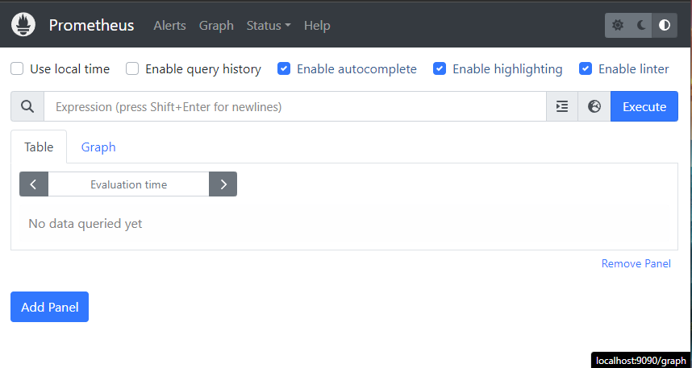
What is Prometheus?
Prometheus is an open-source monitoring and alerting toolkit. It features:
Time-Series Data: Efficiently stores and queries metrics over time.
PromQL: A powerful query language for data retrieval.
Flexible Collection: Uses a pull model to collect metrics.
Built-In Alerting: Supports alerts and integrates with notification systems.
Prometheus is popular for monitoring systems and applications due to its performance and scalability.

Slide 5
Prometheus Alertmanager
Alert Management: Handles alerts from Prometheus server and client applications
Flexible Routing: Directs alerts to the right receiver based on labels.
Silencing & Inhibition: Suppresses noisy alerts and prevents alert storms.
Notification Integrations: Supports email, Slack, PagerDuty, and more.
Grouping: Clusters related alerts to reduce notification fatigue.

Slide 6
What is Mattermost and RocketChat?
Mattermost and Rocket.Chat are open-source messaging platforms designed for team collaboration. They offer:
Real-Time Communication: Instant messaging and discussions.
Customization: Flexible with plugins and integrations.
Deployment Options: Self-hosted or cloud-based.
Integration: Connect with various tools for streamlined workflows.
Both platforms provide secure, scalable solutions for team communication and collaboration

Slide 7
Clarifying System Integration:
From Misconception to Efficiency
Initial Challenge: Assumed Alertmanager was integrated into Prometheus server's source code.
Reality Check: Discovered Alertmanager operates as a separate, autonomous component.
Insights Gained: Deepened understanding of system architecture and deployment complexities.

Slide 8
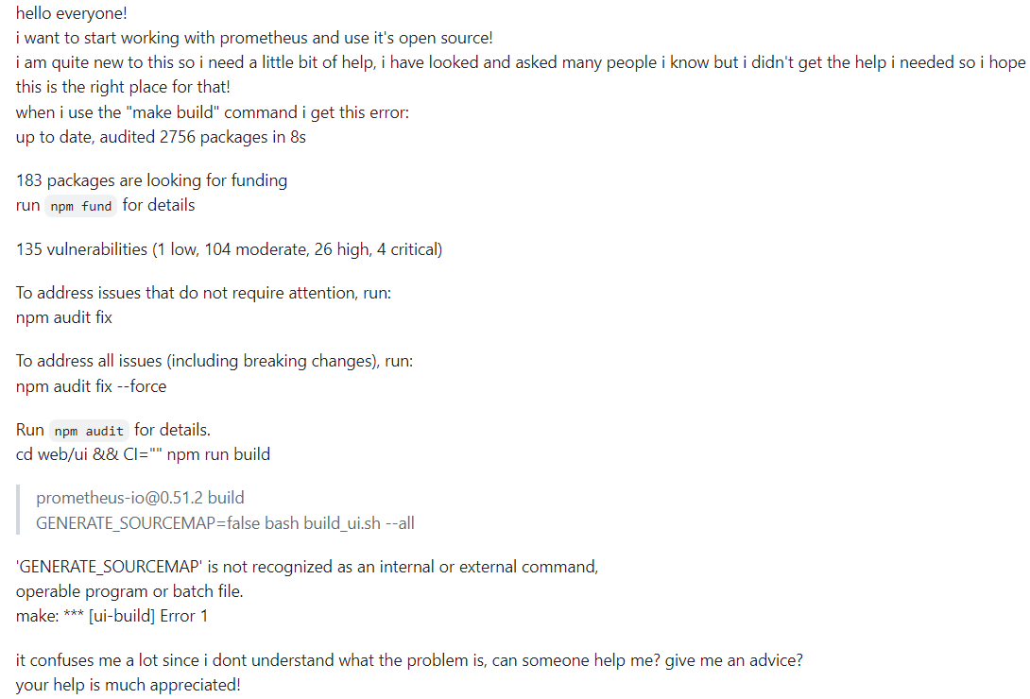
Community Support in Overcoming Compilation Challenges

Slide 9
Enhancing Community Support through
Comprehensive Documentation
Existing documentation in Prometheus Git repository lacked detail.
Key Outcome: Created extensive documentation.
Contributed to the community with updated installation documents.

Slide 10
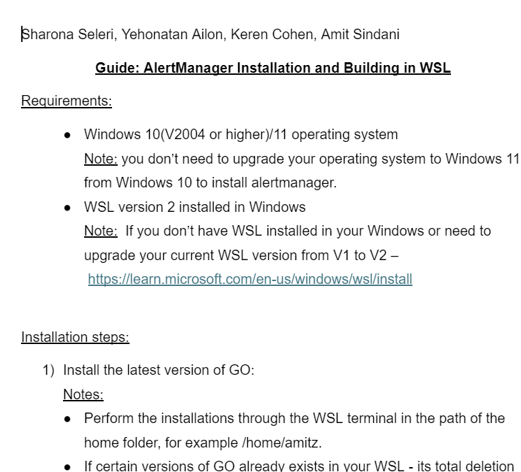
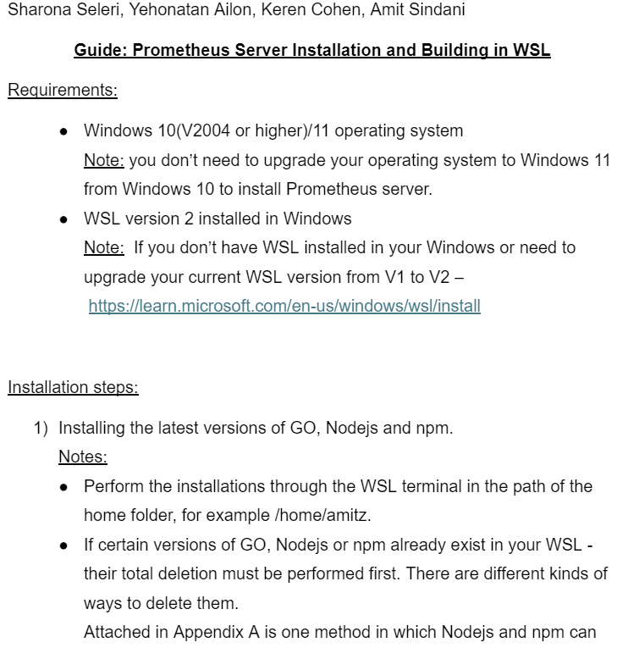
Comprehensive Installation Guides

Slide 11
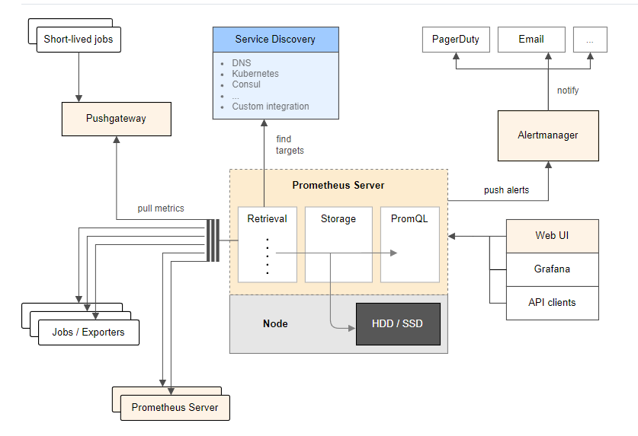
Architecture overview

Slide 12
Acknowledgments
First and foremost, thank you Dr. Hadar Binsky for guiding us throughout the project!
And thank you all for your attention and interest.

